Slide 1
Fuzzy Set
Course : COMP6065001 Artificial Intelligence
Effective Period : September 2023
Session : 12

Slide 2
Learning Outcomes
At the end of this session, students will be able to:
LO 3: Apply various techniques to an agent when acting under certainty

Slide 3
Outline
Element of Sets
Membership Function
Crisp Sets
Fuzzy Sets
Fuzzy Membership Function
Difference between Fuzzy and Probability

Slide 4
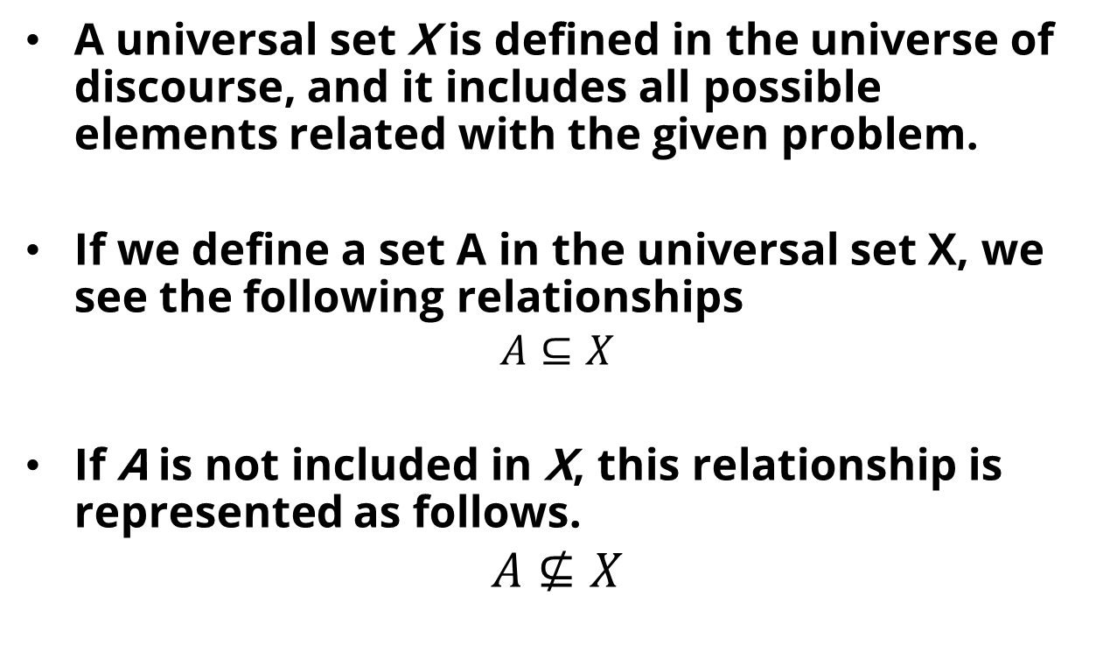
Elements of Set
A universal set X is defined in the universe of discourse, and it includes all possible elements related with the given problem.
If we define a set A in the universal set X, we see the following relationships
$$A⊆X$$
If A is not included in X, this relationship is represented as follows.
$$A⊈X$$

Slide 5
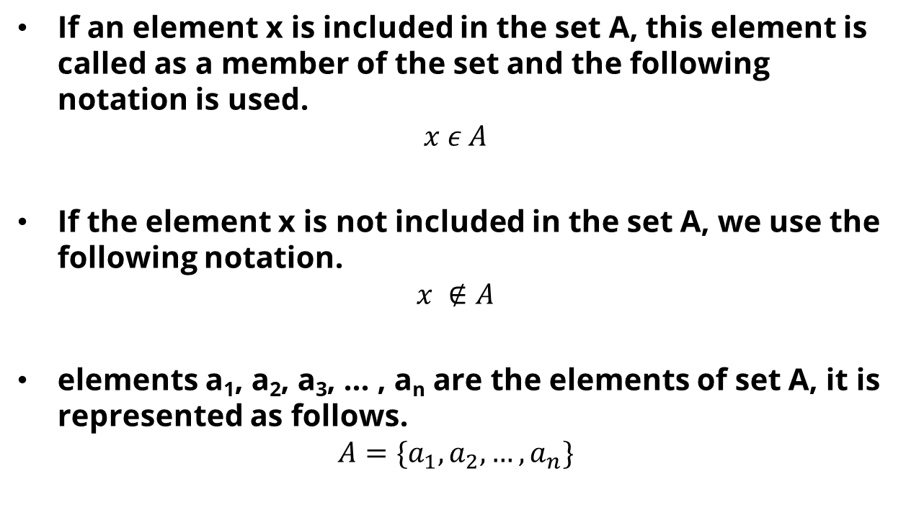
Elements of Set
If an element x is included in the set A, this element is called as a member of the set and the following notation is used.
$$x ε A$$
If the element x is not included in the set A, we use the following notation.
$$x ∉A$$
elements a₁, a₂, a₃, … , a_{n} are the elements of set A, it is represented as follows.
$$A=\{a_{1}, a_{2}, …, a_{n}\}$$

Slide 6

Elements of Set
if the elements of set B should satisfy the conditions P₁, P₂, … , P_{n}, then the set B is defined by the following.
$$B=\{b|b satifies p_{1},p_{2},…,p_{n}\}$$

Slide 7

Membership Function
Membership Function is
For Set A, we defined membership function $μ_{A}$ such as:
$$μ_{A}\left(x\right)=\begin{matrix}1 , if and only if x∈A \\ 0, if and only if x∉A\end{matrix}$$

Slide 8
Crisp Set
Crisp Set is another way to say a set
In Crisp Set, the element of the set is 1 (element of the set) and 0 (not the element of the set)
However, the condition in the real world is not crisp. Most of the time, we defined the condition in ambiguous statement.
For Example: enough sugar, cheap and etc.
Handling the ambiguous statement, we need to apply a threshold in pre-processing or post-processing step.

Slide 9
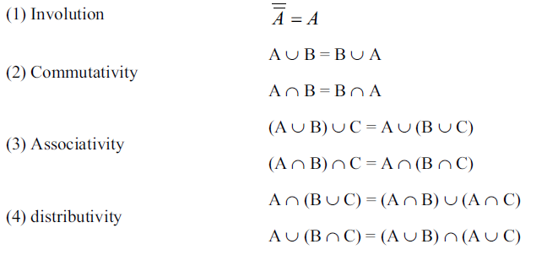
Features of Crisp Set

Slide 10
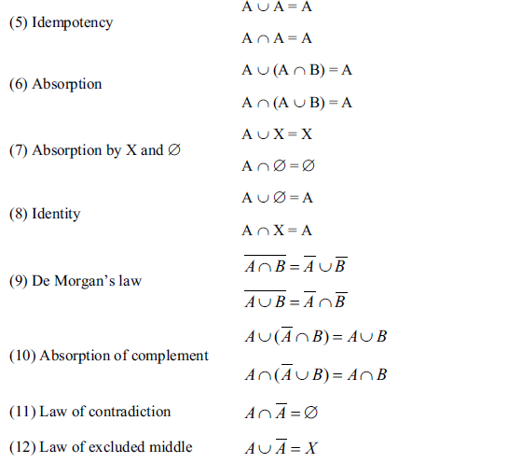
Features of Crisp Set

Slide 11
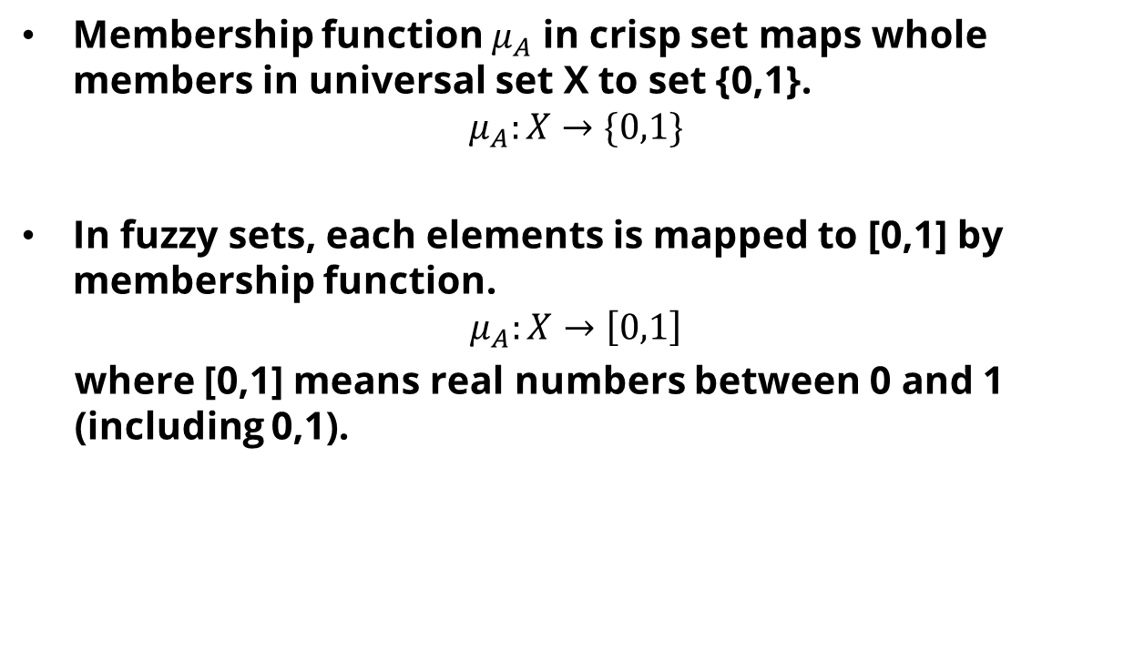
Fuzzy Set
Membership function $μ_{A}$ in crisp set maps whole members in universal set X to set {0,1}.
$$μ_{A}:X→\{0,1\}$$
In fuzzy sets, each elements is mapped to [0,1] by membership function.
$$μ_{A}:X→\left[0,1\right]$$
where [0,1] means real numbers between 0 and 1 (including 0,1).

Slide 12
Example of Fuzzy Set
There is a statement
“Budi is young”.
Is this a statement have a True or False value?

Slide 13
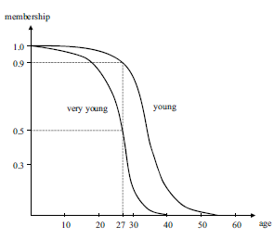
Example of Fuzzy Set
Based on the previous example, the term “young” is ambiguous.
To represent the meaning of “ambiguous" exactly, it would be necessary to define its membership function
When we refer "young", there might be age which lies in the range [0,60] and we can account these "young age" in these scope as a continuous set.
Figure 1: Fuzzy Set representing young and very young

Slide 14
Example of Fuzzy Set
if we follow the definition of "young" as in the figure 1, ten-year-old boy may well be young.
the possibility for the "age ten” to join the fuzzy set of "young is 1.
The "age twenty-seven" is 0.9.
But we might not say young to a person who is over sixty and the possibility of this case is 0.
Figure 1: Fuzzy Set representing young and very young

Slide 15
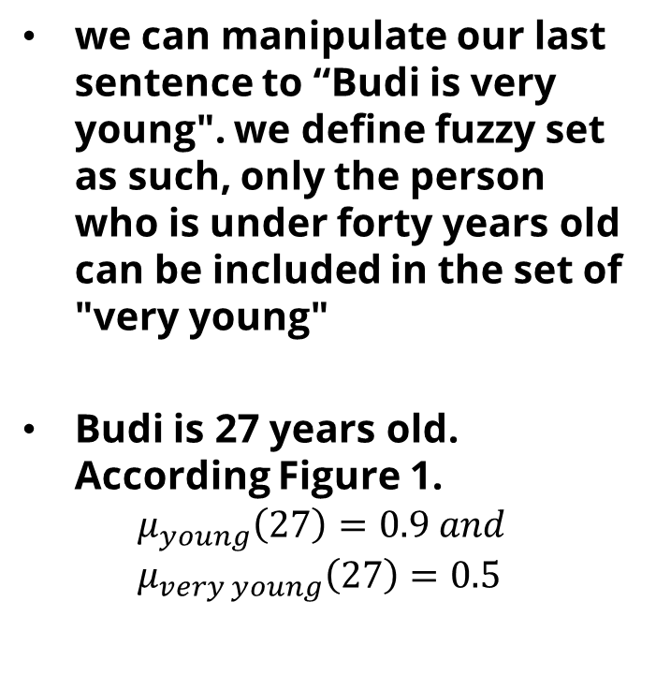
Example of Fuzzy Set
we can manipulate our last sentence to “Budi is very young". we define fuzzy set as such, only the person who is under forty years old can be included in the set of "very young"
Budi is 27 years old. According Figure 1.
$$μ_{young}\left(27\right)=0.9 and \\ μ_{very young}\left(27\right)=0.5$$
Figure 1: Fuzzy Set representing young and very young

Slide 16
Advantages of Fuzzy Set
Store and Process the hidden information
Assume we have two mathematician
In Crisp set, both have same ability
In Fuzzy set, each of them have different ability
Useful for soft-clustering and soft classification

Slide 17
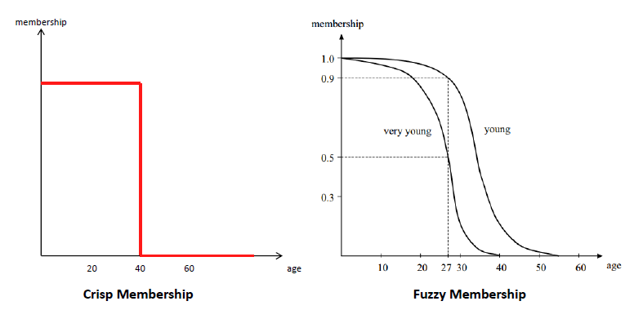
Crisp vs Fuzzy Membership

Slide 18
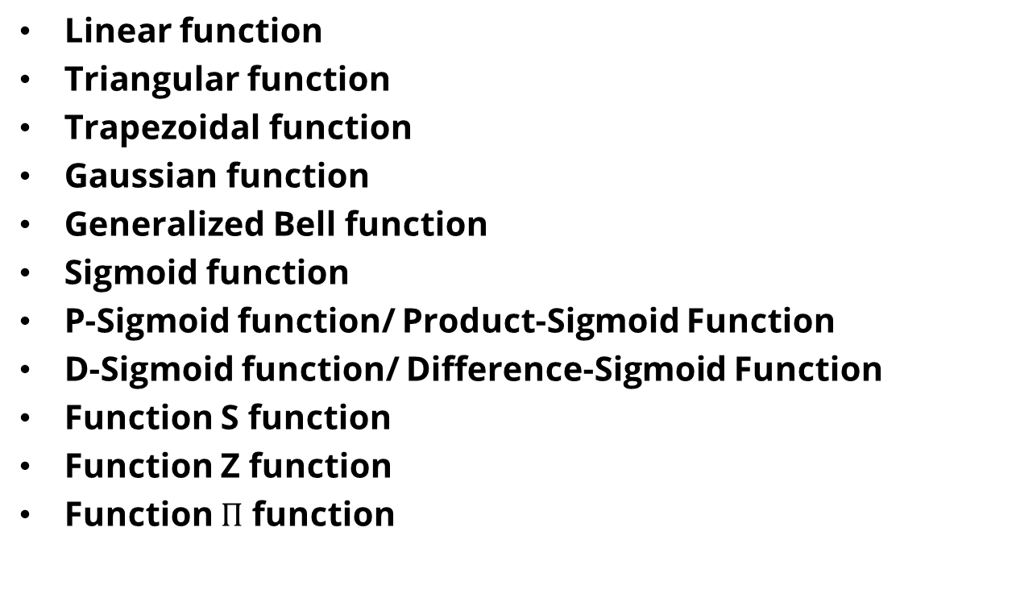
Fuzzy Membership Function
Linear function
Triangular function
Trapezoidal function
Gaussian function
Generalized Bell function
Sigmoid function
P-Sigmoid function/ Product-Sigmoid Function
D-Sigmoid function/ Difference-Sigmoid Function
Function S function
Function Z function
Function $Π$ function

Slide 19
Linear Function

Slide 20
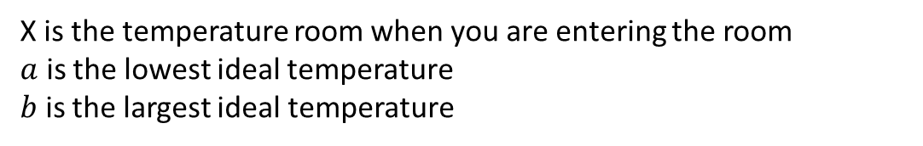

Example of Linear Membership Function
According to WHO, the ideal room temperature for human occupancy is 18-25⁰C. You are entering a room with 20⁰C. What is the degree of comfortability this room.
$$μ_{ideal }=\frac{x−a}{b−a}$$
X is the temperature room when you are entering the room
$a$ is the lowest ideal temperature
$b$ is the largest ideal temperature

Slide 21

Example of Linear Membership Function
According to WHO, the ideal room temperature for human occupancy is 18-25⁰C. You are entering a room with 20⁰C. What is the degree of comfortability this room.
$$μ_{ideal }=\frac{20−18}{25−18}=0.286$$

Slide 22
Triangular function

Slide 23
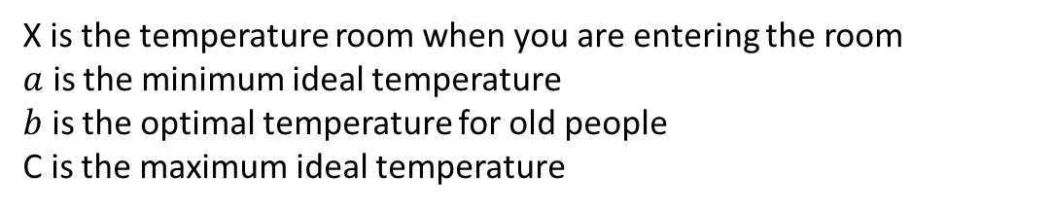
Example of Triangular Membership Function
According to WHO, the ideal room temperature for human occupancy is 18-25⁰C. The most ideal for older people is 20 ⁰C. A old woman enter a room with temperature 22 ⁰C. What is the degree of comfortability this room for this old woman?
X is the temperature room when you are entering the room
$a$ is the minimum ideal temperature
$b$ is the optimal temperature for old people
C is the maximum ideal temperature

Slide 24

According to WHO, the ideal room temperature for human occupancy is 18-25⁰C. The most ideal for older people is 20 ⁰C. A old woman enter a room with temperature 22 ⁰C. What is the degree of comfortability this room for this old woman?
$$μ_{ideal}=\frac{c−x}{c−b}=\frac{25−22}{25−20}=0.6$$

Slide 25
Trapezoidal function

Slide 26
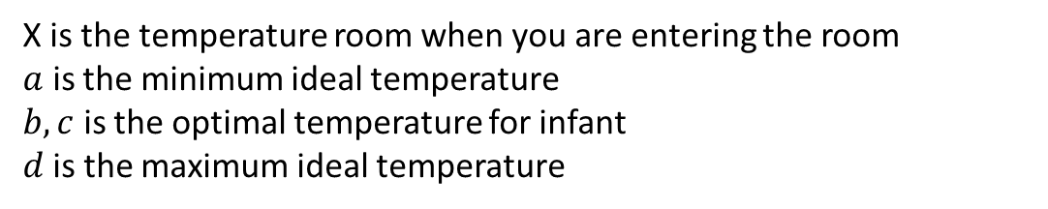
Example of Triangular Membership Function
According to WHO, the ideal room temperature for human occupancy is 18-25⁰C. The ideal for infant is 20-21 ⁰C. A infant sleep with the room temperature at 22 ⁰C. What is the degree of comfortability this room for this infant?
X is the temperature room when you are entering the room
$a$ is the minimum ideal temperature
$b,c$ is the optimal temperature for infant
$d$is the maximum ideal temperature

Slide 27

According to WHO, the ideal room temperature for human occupancy is 18-25⁰C. The ideal for infant is 20-21 ⁰C. A infant sleep with the room temperature at 22 ⁰C. What is the degree of comfortability this room for this infant?
$$μ_{ideal}=\frac{d−x}{d−c}=\frac{25−22}{25−21}=0.75$$

Slide 28
Gaussian function

Slide 29
Generalized Bell function

Slide 30
Sigmoid function

Slide 31

P-Sigmoid function
$$f_{1}\left(x,a_{1}, c_{1}\right) ×f_{2}\left(x,a_{2}, c_{2}\right)$$

Slide 32

D-Sigmoid function
$$f_{1}\left(x,a_{1}, c_{1}\right) −f_{2}\left(x,a_{2}, c_{2}\right)$$

Slide 33
S-Function

Slide 34
Z-Function

Slide 35

Function $Π$ function

Slide 36
How to Determine Membership Function
Interview those who are familiar with the underlying concept and later adjust it based on a tuning strategy
Construct it automatically from data.
Learn it based on feedback from the system performance

Slide 37
Fuzzy Subset

Slide 38

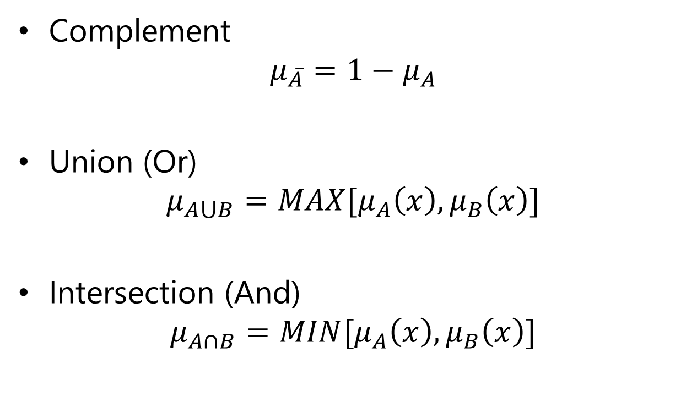


Standard Operation of Fuzzy Set
Complement
$$μ_{\overline{A}}=1−μ_{A}$$
Union (Or)
$$μ_{A⋃B}=MAX[μ_{A}\left(x\right),μ_{B}\left(x\right)]$$
Intersection (And)
$$μ_{A∩B}=MIN[μ_{A}\left(x\right),μ_{B}\left(x\right)]$$
$${,∀}_{x}∈X$$
$${,∀}_{x}∈X$$
$${,∀}_{x}∈X$$

Slide 39
Fuzzy Logic and Probability Theory
Imperfection
Vagueness
Uncertainty
Fuzzy Logic
Probability
Theory

Slide 40
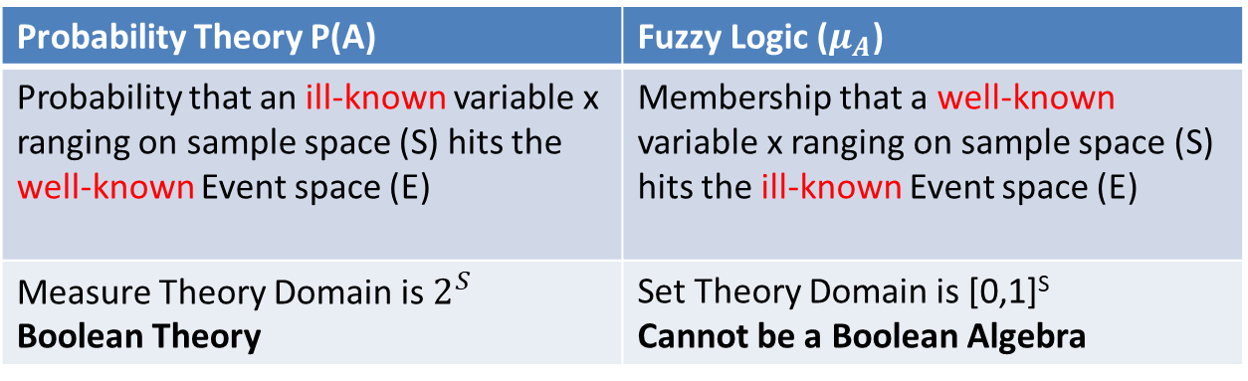
Fuzzy Logic and Probability Theory
Probability Theory P(A) | Fuzzy Logic ($μ_{A}$)
Probability that an ill-known variable x ranging on sample space (S) hits the well-known Event space (E) | Membership that a well-known variable x ranging on sample space (S) hits the ill-known Event space (E)
Measure Theory Domain is $2^{S}$ Boolean Theory | Set Theory Domain is [0,1]^{S} Cannot be a Boolean Algebra

Slide 41
Exercise
According to some research, the normal temperature for place X are 24 until 27 C. While lower than 15 C is cold and Higher than 32 is hot.
Draw the membership function
One day, the temperature of that area are 23 C. Calculate the degree of comfortability according to the previous membership function.

Slide 42
References
Lee, K.H., First Course on Fuzzy Theory and Applications, Springer, 2005

